Slide 1
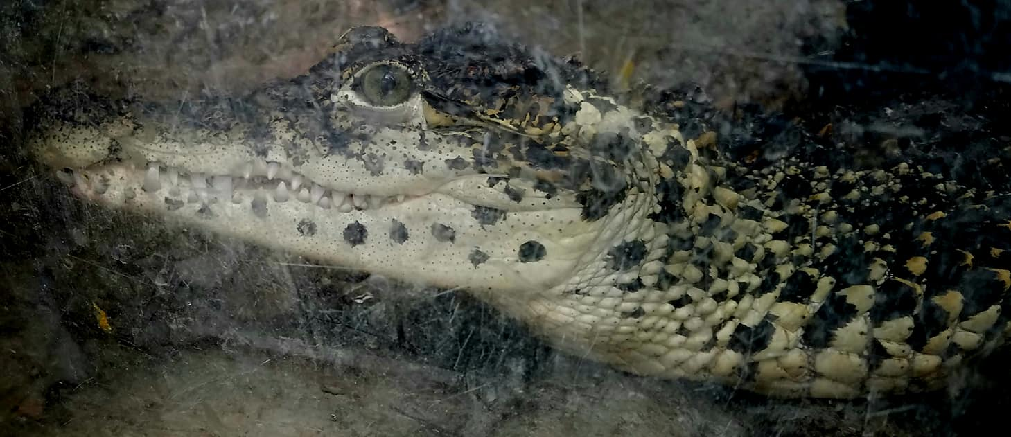
Cuban Crocodile Autonomous Air Systems
KASHMIR WORLD FOUNDATION

Slide 2
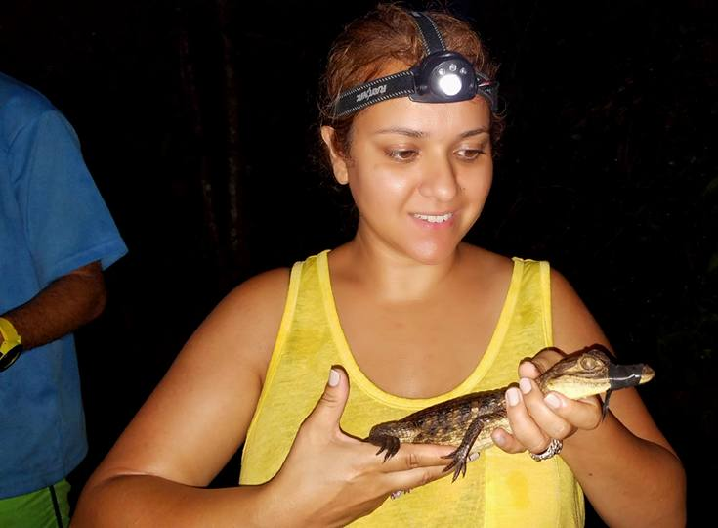
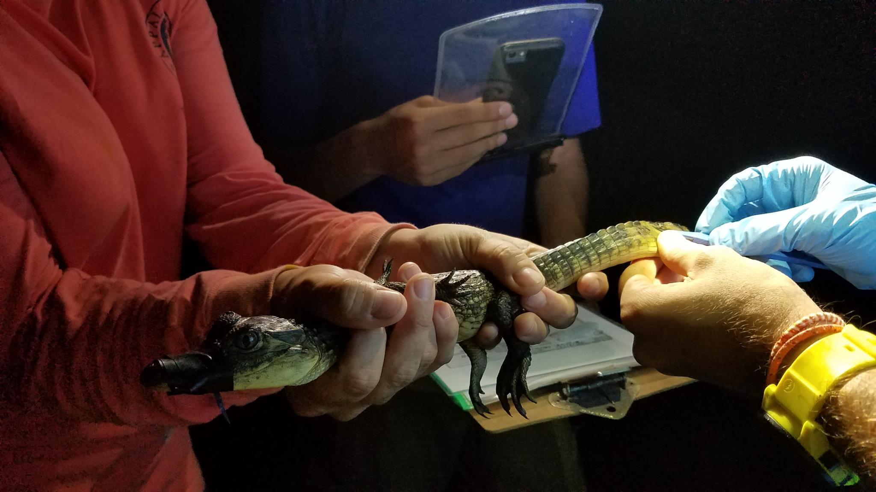
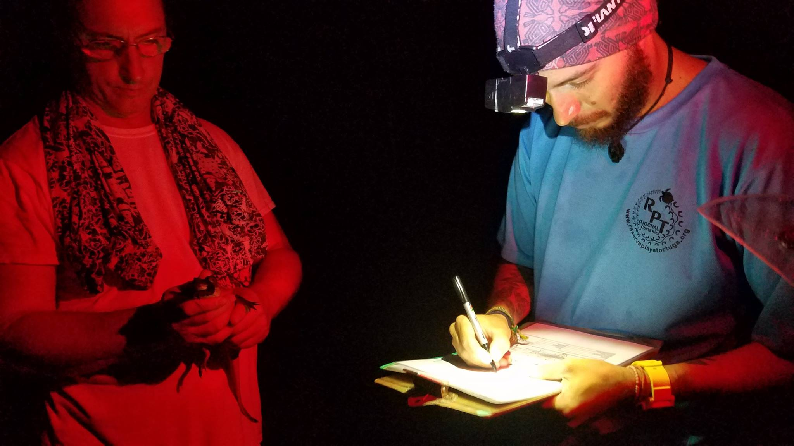
About Kashmir World Foundation
Kashmir World Foundation (KwF) is a nonprofit organization based in the US.
KwF Divisions Include:
Kashmir Academy – Education
Kashmir Robotics – Technology Development
Kashmir Rose – Art Preservation
KwF is a world leader in the development of collaborative-innovative technology systems for protection of endangered species.
In collaboration with Academics, Engineers, & Scientists, KwF develops autonomous ground, air and marine systems for wildlife conservation and counter poaching.

Slide 3
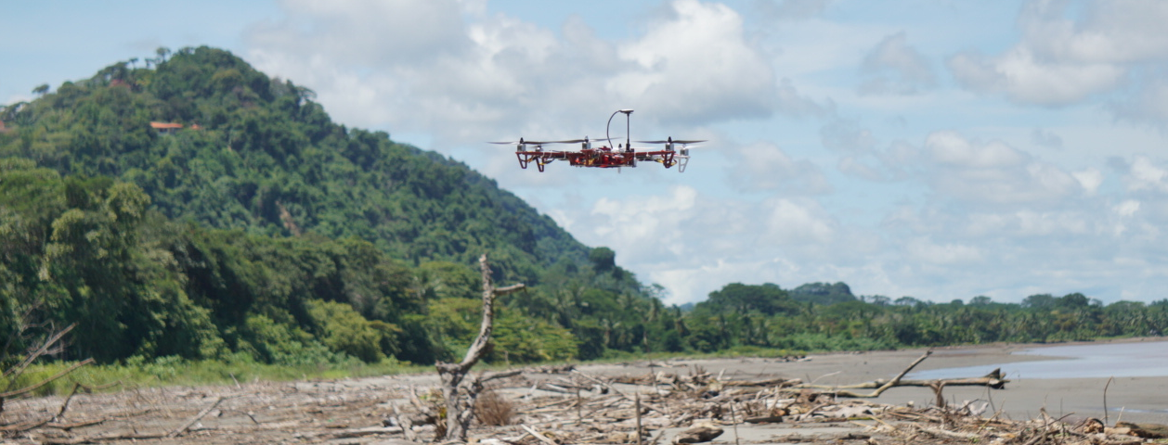
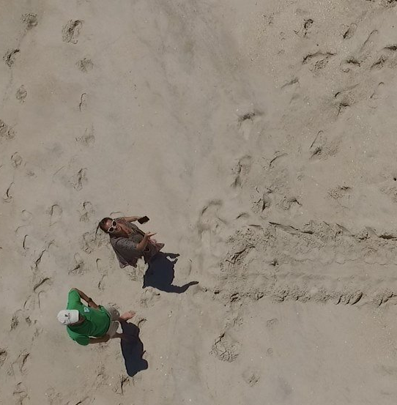
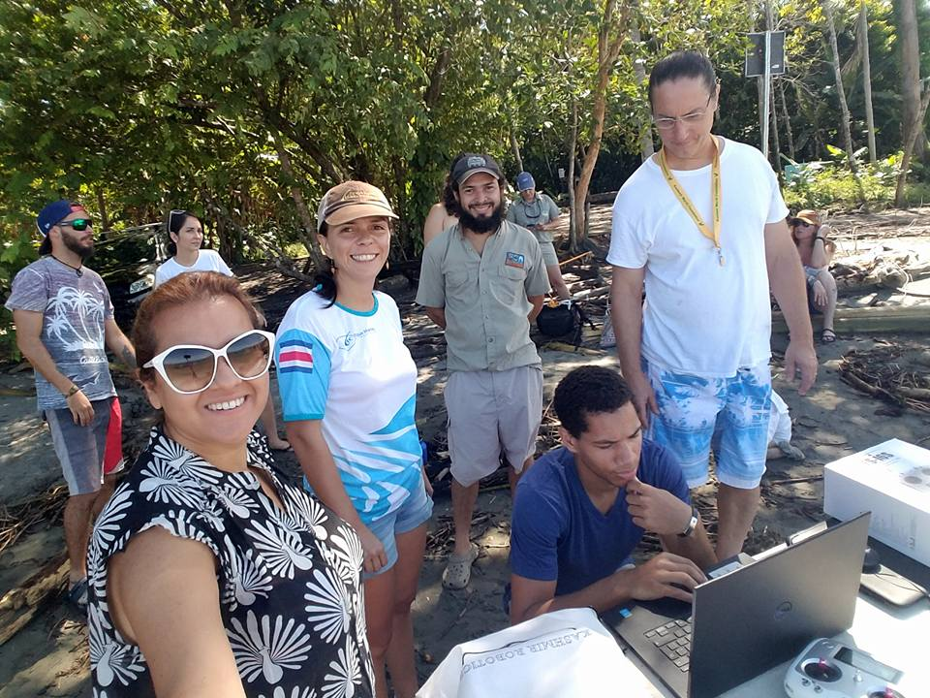
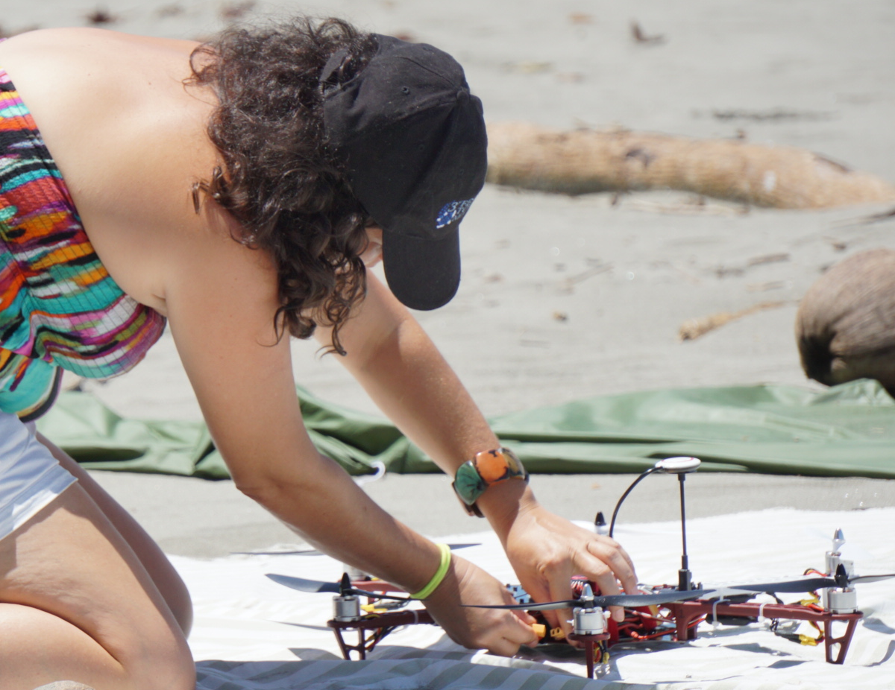
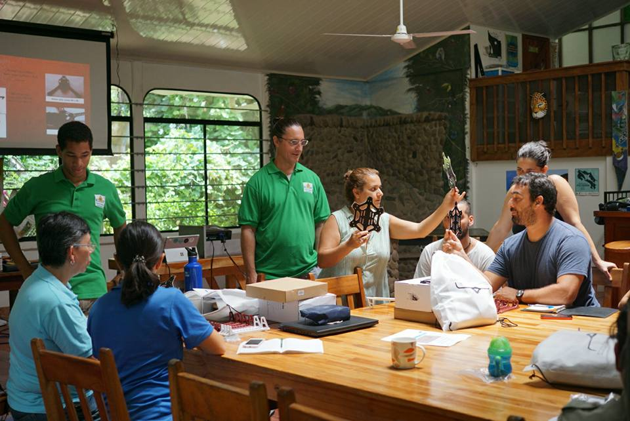
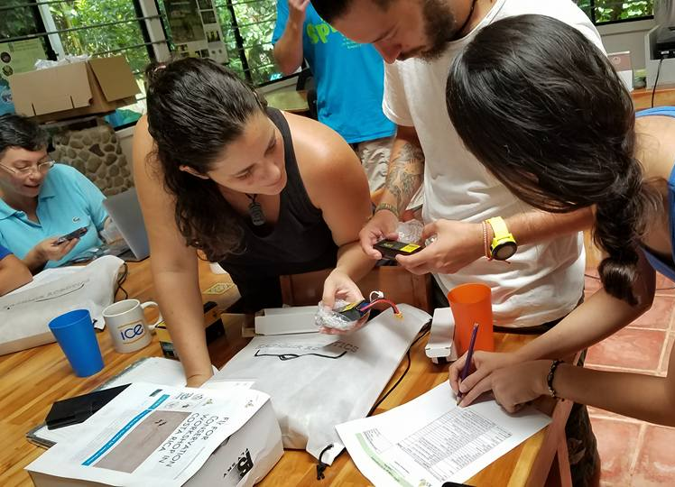
Fly for Conservation Workshops
KwF empowers conservationists with education and training on unmanned aerial systems (UAS) for a new perspective and scope in problem solving.
Fly for Conservation workshops unite Drone designers, engineers and wildlife conservationists in collaboration to create advanced technological solutions for common barriers to conservation efforts.
The goal of the workshop is to enable a network of leading wildlife conservationists to build, operate and maintain UAS in the field while sharing data collected from the drones to develop the machine learning needed to process data onboard the aircraft in real time.

Slide 4
Critically Endangered Cuban Crocodile
Cuban Crocodiles are Critically Endangered due to poaching, habitat loss and hybridization with native American Crocodiles.
Cuban Crocodiles only reside in two areas: 300 square kilometers of the Zapata Swamp and a small part of the Isle of Youth.
Monitoring the population, evaluating threats, and protecting them from poaching remain difficult and enduring problems.
Autonomous aerial systems can help, and over time will learn, adapt, and evolve through machine learning – getting ahead and staying ahead of evolving threats.

Slide 5
Cuban Crocodile Expedition
KwF will conduct a Fact Finding Mission in partnership with Cuban Crocodile Team to determine challenges to Cuban Crocodile survival.
Learn about current monitoring methods of Cuban Crocodiles.
Learn about the challenges biologists face when conducting monitoring surveys.
Build a Drone in the field with Cuban Croc Specialists.
Gather aerial data of habitat using an unmanned systems.
Cuban Croc Team will retain the drone built and continue testing in the field and providing feedback on challenges.
KwF Team will customize drone for habitat sustainability.
KwF will create video and maps from aerial data collected and share with Cuban Croc Team.

Slide 6
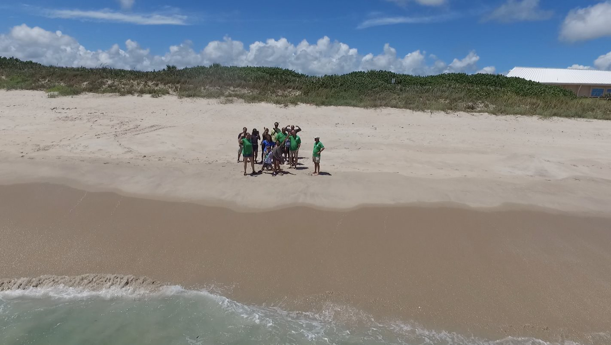
For more information please contact us:
Princess Aliyah, Executive Director KwF
aliyah@kashmirworldfoundation.org
Dr. Ron Pandolfi, Director of Kashmir Robotics
ronald@kashmirworldfoundation.org
www.kashmirworldfoundtion.org
www.mishell.org
www.wcUAVc.com

